Slide 1
Basic Laravel

Slide 2

Who Am I?
Linkedin
Muhammad Ridwan Effendi - Ridwan
Project Manager at Azura Labs (2021 - Now)
1+ Years Experiences
Tester Azura Labs (2020 - 2021)
1+ Years Experiences
Runner Postman Automation
Selenium Automation
Linkedin

Slide 3
Outline
Understanding Laravel
Understanding Composer
Understanding Routing
Understanding MVC Concept

Slide 4
Laravel

Slide 5
What is Laravel?
Laravel is the only framework that helps you to maximize the use of PHP in the website development process.
Laravel was launched in 2011 and has experienced quite an exponential growth. In 2015, Laravel was the most starred framework on Github.
This framework follows the MVC or Model View Controller structure
Laravel is used to build anything from small projects to high-end enterprise scale.
Documentation: https://laravel.com/docs/9.x
Self-Study
Programmer Zaman Now - https://www.youtube.com/watch?v=ClMX6TXvh_o&t=10823s
Web Programming UNPAS - https://www.youtube.com/watch?v=HqAMb6kqlLs&list=PLFIM0718LjIWiihbBIq-SWPU6b6x21Q_2
Laracast - https://laracasts.com/topics/laravel

Slide 6
Composer

Slide 7
What is Composer?
Package manager application to install various PHP files, especially libraries and frameworks made using PHP.
Package manager is a designation for applications in charge of managing dependencies or dependencies between applications.
Composer inspired by npm (node package manager) from javascript.
The majority of modern websites are no longer made from scratch, but instead utilize various libraries or other existing program code
Bootstraps 4 → jQuery dan Popper JS
Notes:
Namun Bootstrap sendiri juga tidak dibuat dari nol. Secara internal, Bootstrap butuh library jQuery dan Popper JS (untuk Bootstrap 4). Di sini kita bisa sebut bahwa Bootstrap memiliki dependency atau ketergantungan kepada jQuery dan Popper JS. Tanpa kedua file ini, efek JavaScript Bootstrap tidak bisa jalan.

Slide 8
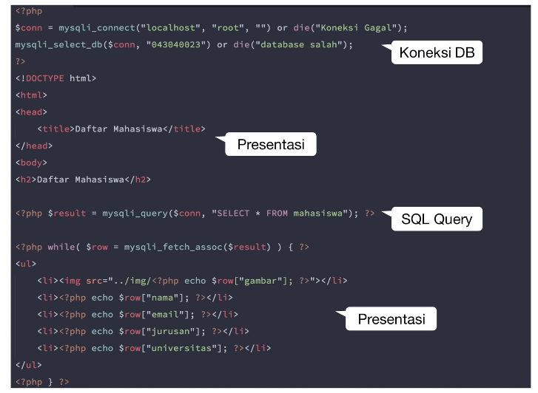

Slide 9
Create Laravel Project
Install Xampp / Mamp → We need php
Run Xampp / Mamp
Open phpMyAdmin
create DB
Install Composer → https://getcomposer.org/download/
Create Project
Open terminal / cmd
Enter the folder as you wish
Run → composer create-project laravel/laravel project-name
Open project using text editor (e.g: visual code)
Setting DB
Open file .env
Settings according to your environments (port mysql xampp: 3306, mamp: 8889)
Check with laravel default migration
Run command line (Terminal VS Code) → php artisan migrate
Notes:
In the example above, notice that we did not have to tell PHP which data type the variable is.
PHP automatically converts the variable to the correct data type, depending on its value.

Slide 10
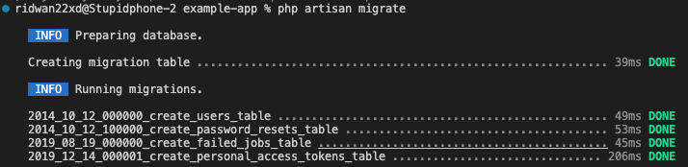

Slide 11
Routing

Slide 12
Routing
Url, or address to a certain page so that it can be accessed via a web browser
Making it easier for us when switching pages
Type of route:
api.php → To create a routing API (create a core service API using Laravel).
channels.php → To create routing events that are broadcasting events (e.g: notifications)
console.php → To create a routing command that runs in the terminal. So we can also create our own artisan orders.
web.php → To access the page in a web browser
Folder: routes/….
Notes:
In the example above, notice that we did not have to tell PHP which data type the variable is.
PHP automatically converts the variable to the correct data type, depending on its value.

Slide 13
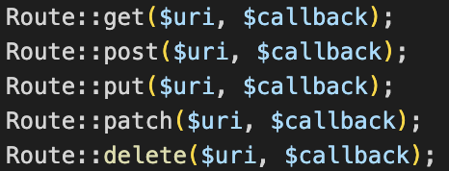
Metode Routing
GET → Get data from DB
POST → Create data and save to DB
PUT → Edit data in DB (Multiple components, eg: profile)
PATCH → Edit data in DB (Some components, eg: password)
DELETE → Delete data in DB
Notes:
php artisan route:list

Slide 14
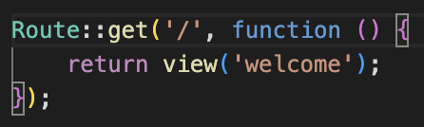
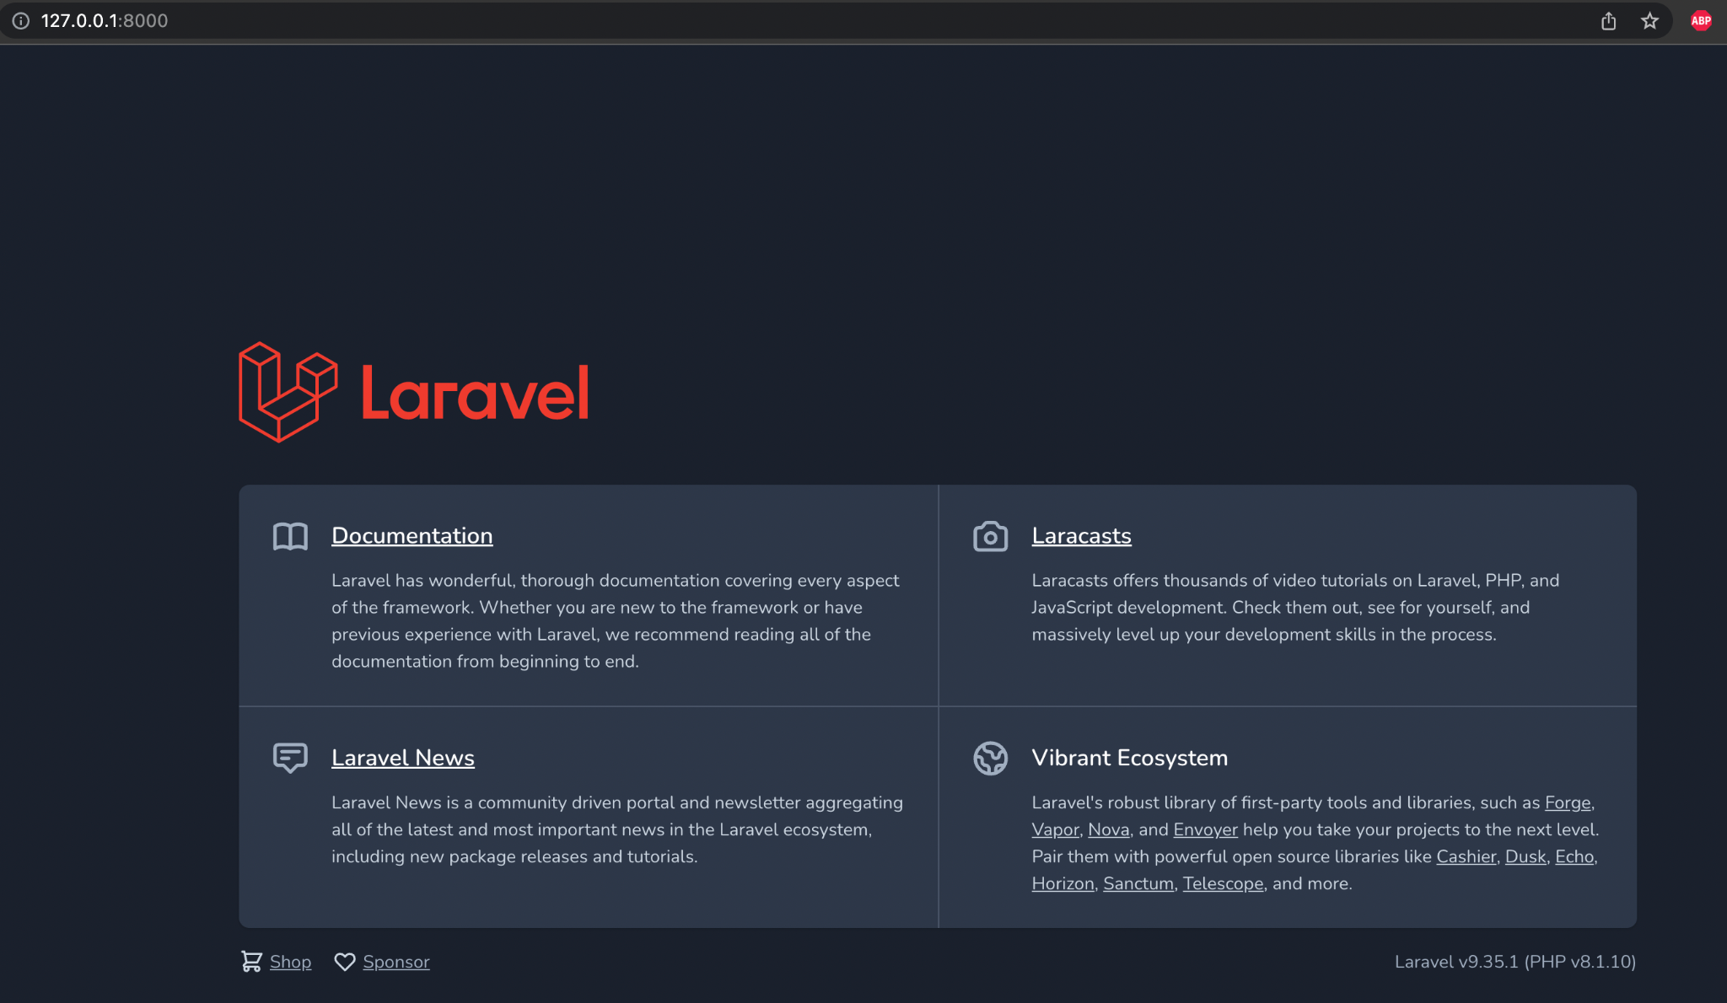
Routing - Default Route
Buka web.php (routes/web.php)
Notes:
In the example above, notice that we did not have to tell PHP which data type the variable is.
PHP automatically converts the variable to the correct data type, depending on its value.

Slide 15
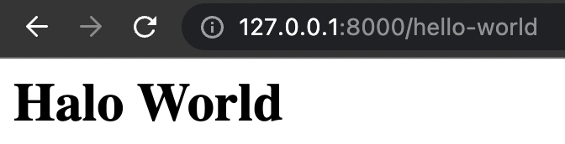
Routing - Simple Route
Buka web.php (routes/web.php)
Add some code to use another route Route::get('/hello-world', function() { return '<h1>Hello World</h1>'; });
Notes:
In the example above, notice that we did not have to tell PHP which data type the variable is.
PHP automatically converts the variable to the correct data type, depending on its value.

Slide 16
MVC

Slide 17
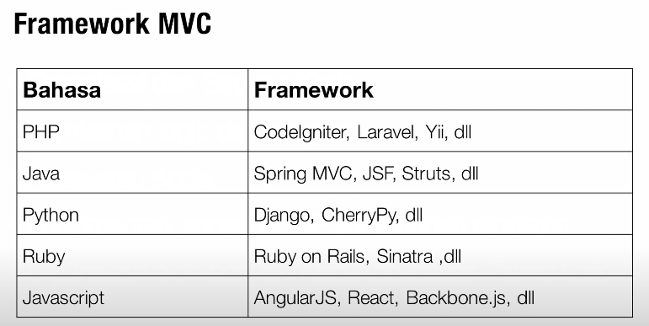
Why MVC?
Code organization and structure
Separation of logic and view
Maintenance code
Used by many web application frameworks

Slide 18
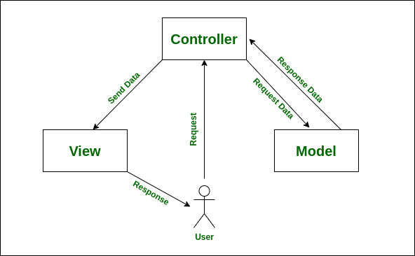
MVC Concept
Architectural concepts in the development of web-based applications that divide web applications into 3 major parts.
Each section has its own duties and responsibilities.
Model
View
Controller
Notes:
In the example above, notice that we did not have to tell PHP which data type the variable is.
PHP automatically converts the variable to the correct data type, depending on its value.

Slide 19
Model
Organizing, preparing, manipulating and organizing data (from the database) according to instructions from the controller.
Folder: app/Models/….
Create model in laravel php artisan make:model ModelName → php artisan make:model Flight
Documentation: https://laravel.com/docs/9.x/eloquent#generating-model-classes
Notes:
In the example above, notice that we did not have to tell PHP which data type the variable is.
PHP automatically converts the variable to the correct data type, depending on its value.

Slide 20
View
Present information (which is easy to understand) to the user according to the instructions from the controller.
Folder: resources/views/….
Create view in laravel php artisan make:view ViewName → php artisan make:view index
Using blade
Notes:
In the example above, notice that we did not have to tell PHP which data type the variable is.
PHP automatically converts the variable to the correct data type, depending on its value.

Slide 21
View - Blade
Blade is the simple, yet powerful templating engine that is included with Laravel
Naming → viewname.blade.php
Documentation: https://laravel.com/docs/9.x/blade
Notes:
In the example above, notice that we did not have to tell PHP which data type the variable is.
PHP automatically converts the variable to the correct data type, depending on its value.

Slide 22
Controller
Set what the model should do, and which views should be displayed upon request from the user.
However, sometimes requests from users do not always require action from the model.
Displaying a form page for user registration.
Folder: app/Http/Controllers/….
Create model in laravel php artisan make:controller ControllerName → php artisan make:controller ProvisionServer
Documentation: https://laravel.com/docs/9.x/controllers#writing-controllers
Notes:
In the example above, notice that we did not have to tell PHP which data type the variable is.
PHP automatically converts the variable to the correct data type, depending on its value.

Slide 23
MVC - Training

Slide 24
Company - CRUD 1
Create Model and Migration → php artisan make:model Company -m
Add some code in Migration (database/migrations/2022…..) $table->string('name'); $table->string('email'); $table->string('address');
Add some code in Model (app/Models/Company.php) protected $fillable = ['name', 'email', 'address'];
Migrate → php artisan migrate
Create Company Controller → php artisan make:controller CompanyController
Add Model Company in controller (app/http/Controllers/CompanyController.php) use App\Models\Company;
Add some code in Controller (app/Http/Controllers/CompanyController.php) https://codefile.io/f/IAjFSBeqxBmyhwmO5aGR
Add some code in Route (routes/web.php) use App\Http\Controllers\CompanyController; Route::resource('/companies', CompanyController::class);
Notes:
$fillable. Properti tersebut yang dinamakan Mass Assigment di Laravel. Dimana di dalamnya kita menambahkan field-field yang diizinkan untuk melakukan manipulasi data.

Slide 25
Company - CRUD 2
Create Blade Views File (resources/views/companies)
index.blade.php → https://codefile.io/f/21VqPMGL69oOY2LmG28h
create.blade.php → https://codefile.io/f/XeTqCqG3X2H1h7T15Cdm
edit.blade.php → https://codefile.io/f/1EwupHt4xFYnjqul2Kpy
Notes:
$fillable. Properti tersebut yang dinamakan Mass Assigment di Laravel. Dimana di dalamnya kita menambahkan field-field yang diizinkan untuk melakukan manipulasi data.

Slide 26
Homework
Task
Create project laravel → portofolio
Using MVC concept create some page
home
about
education (CRUD)
Years → 2013 - 2016
Educational → SMA
Institution → SMAN 3 Semarang
projects (CRUD)
Years → 2013 - 2014
Role → BackEnd (Node.js)
Project → TokoMedia
Description → Create API Transaction
Assesment
Finish task
Upload project in gitlab
Tele → @Ridwan22XD
Note
if you stuck in project, you can ask in grup Learn With Azura
Recommended for those who want to learn laravel

Slide 27
Thanks!
Do you have any questions?

Slide 28
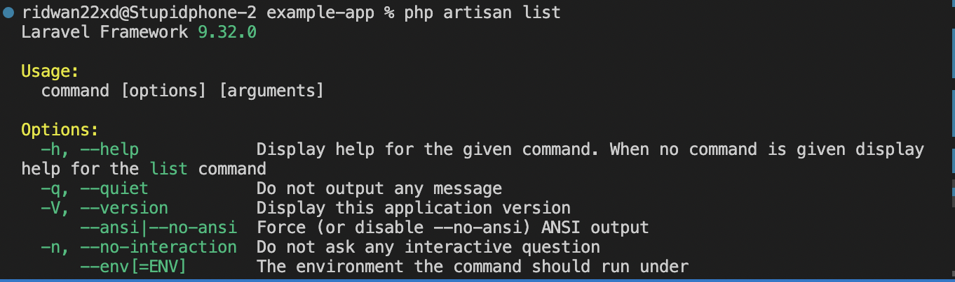
Tips
Read documentation
https://laravel.com/docs/9.x
run CLI → php artisan list
Port MySQL
Mac → 8889
Windows → 3306

Slide 29

Learn with Azura

Slide 30
More Information
Opportunity:
Bootcamp
Internship
Part-time
Full-time
Follow IG Azura → azuralabs.id https://www.instagram.com/azuralabs.id/
Follow Linkedin Azura Labs → azuralabs.id https://www.linkedin.com/company/azuralabsid/mycompany/
Blog Azura https://blog.azuralabs.id/

Slide 31

Feedback

Slide 32
References
https://jagongoding.com/web/memahami-konsep-mvc/
https://www.youtube.com/watch?v=tBKOb8Ib5nI
https://www.dicoding.com/blog/apa-itu-mvc-pahami-konsepnya/
https://towardsdatascience.com/everything-you-need-to-know-about-mvc-architecture-3c827930b4c1
https://www.niagahoster.co.id/blog/laravel-adalah/
https://www.duniailkom.com/tutorial-belajar-laravel-cara-menginstall-composer/#:~:text=Untuk%20menginstall%20Laravel%2C%20kita%20disarankan,framework%20yang%20dibuat%20menggunakan%20PHP.
https://bahasaweb.com/belajar-routing-di-laravel/
http://www.newbienote.com/2017/02/tipe-tipe-metode-routing-di-laravel-54.html
https://codepolitan.com/blog/belajar-routing-laravel
https://informatika.uc.ac.id/id/2019/09/laravel-routing/
https://laravel.com/docs/9.x/blade
https://santrikoding.com/tutorial-set/tutorial-laravel-9-untuk-pemula
https://techvblogs.com/blog/laravel-9-crud-application-tutorial-with-example
Notes:
In the example above, notice that we did not have to tell PHP which data type the variable is.
PHP automatically converts the variable to the correct data type, depending on its value.

